Slide 1
Data - A new era
Unikey - KGOD6253

Slide 2

Information
Information is something which informs. It is a tool by which wise decisions are made.
Information is selected from data by the methods in the field of informatics

Slide 3
Informatics
Informatics is a viable solution to many common fields in which there is a lot of data for example:
Health
Finance
Economics
Etc.
This information is extracted using data mining methods.
One example of informatics in the field of health

Slide 4
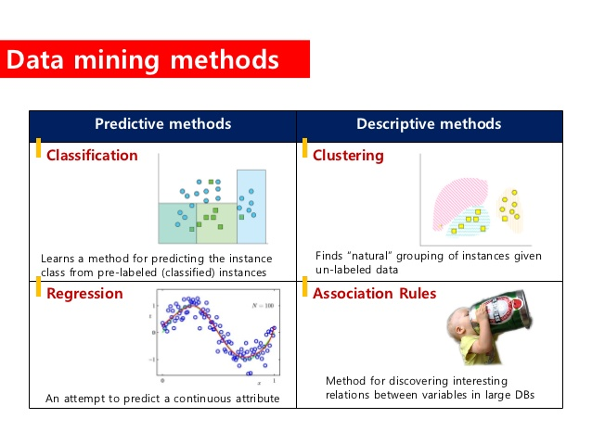

Slide 5
Applications of Informatics
Industries to benefit from AI.
Edstem’s estimated growth by the end of 2020.
The impact of cryptocurrencies on the real world by 2020.
How an excess or deprivation of sleep can affect the human body.

Slide 6
Industries to benefit from AI

Slide 7
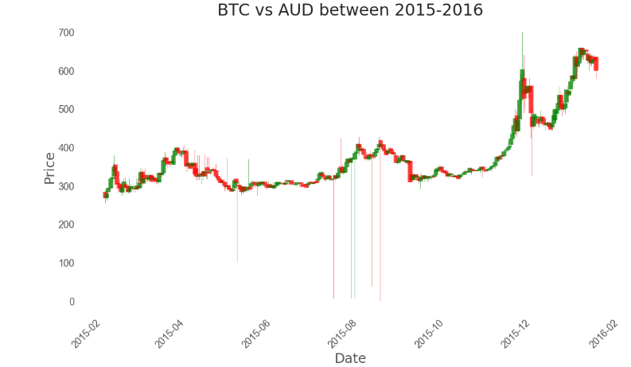
Price showing increasing adoption for BTC

Slide 8
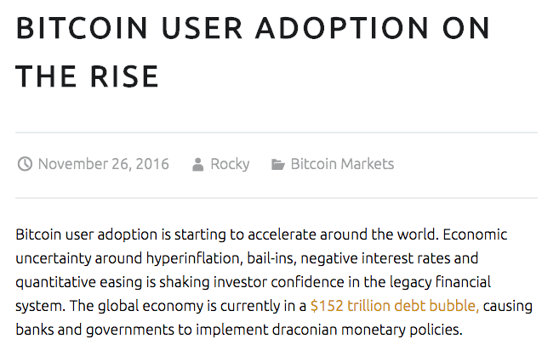


Slide 9
Allocated funds
Surveys are conducted to gather data
Funds are not just used for gathering research.
Budget constraints are implemented.
 | XYZ Informatics Budget
 | % of Funds Allocated | Summary
 |  | Researchers
 |  | $3,750
 |  | Programmers
 |  | $6,000
 |  | Equipment
 |  | $550
 |  | Office expenses
 |  | $750
Example budget plan of an informatics division in a company

Slide 10
Overall advantages of informatics
Unorganized data is given meaning.
An organization can create a plan using information.
Informatics can be applied to almost any field.
An objective without a goal or research can be very deadly.
Long term value is created in the society.

Slide 11
Disadvantages
Gathering data is an expensive process.
Informatics and analysis is costly
Analysis is not an autonomous process.

Slide 12
Conclusion
Informatics is an essential component in an organization

Slide 13
Sources
https://coursesearch.unimelb.edu.au/majors/140-informatics
http://www.zentut.com/data-mining/data-mining-techniques
https://cryptohustle.com/bitcoin-user-adoption-on-the-rise
Lecture 01 Slides, Alan Feteke
Project Stage 2, Karan Goda

